Slide 1

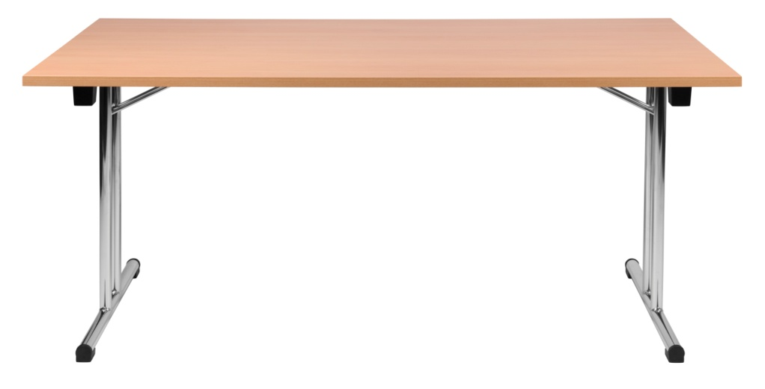
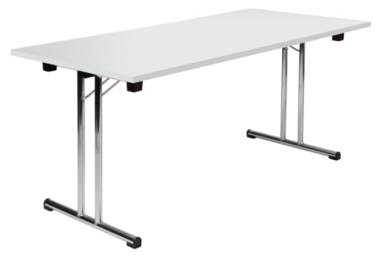
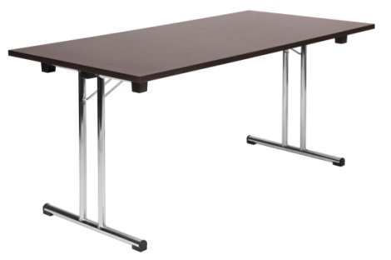
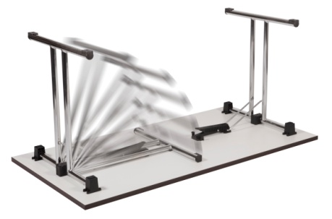
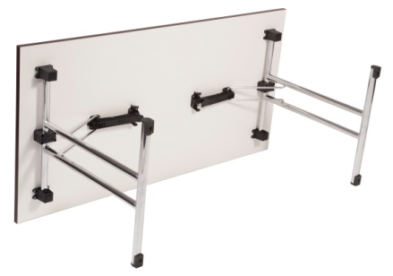
SPACE FOLDING TABLE
PRODUCT SHEET
FURNITURE
Fully assembled executive folding table
Robust 25mm top
Bright chrome folding leg frames
Frame locking mechanism
Solid build
Stackable when folded
Available from stock in beech, white or wenge effect
Table Height | 73 cm
Table Top Width | 160 cm
Table Top Depth | 80 cm
Table Top Thickness | 2.5 cm
Carton Depth | 12.5 cm
Carton Width | 164 cm
Carton Height | 83.5 cm
Box Volume (unit volume) | 0.172 cm
Net Weight | 28 Kg
Gross Weight | 31 kg
N.B: All measurements are approximate
INSERT YOUR PRICE HERE

